Slide 1

Image Processing
Unit2-Multimedia Computing

Slide 2
What is an Image?
A digital image is a two-dimensional representation of visual information stored in a computer as numerical values. Every image consists of tiny elements called pixels (Picture Elements).
-Each pixel stores brightness and color information.
Example
A digital image of size
1920 × 1080
contains
1920×1080=2,073,6001920 pixels.
A pixel is the smallest addressable unit of a digital image.
Components of Digital Images
Digital Image
│
├── Pixels
├── Resolution
├── Color Depth
├──
── Compression
-Resolution defines the number of pixels in an image.
Example
640 × 480
-Color depth specifies the number of bits used to represent the color of one pixel.

Slide 3
Color Depth
Color depth specifies the number of bits used to represent the color of one pixel.
Color Depth | Number of Colors
1 bit | 2
8 bit | 256
16 bit | 65,536
24 bit | 16.7 Million
32 bit | 16.7 Million + Alpha
Mathematical Representation Image Storage Storage=Width×Height×BitDepth
ExampleImage1024 × 768, 24-bit
Storage1024×768×24=18,874,368bits
Convert to bytes 818,874,368​=2,359,296 bytes≈ 2.25 MB

Slide 4
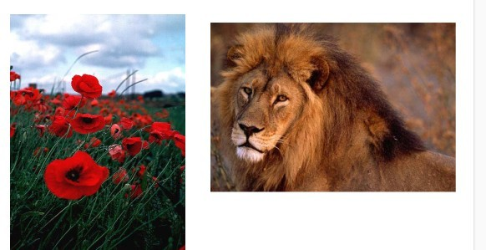
What is an Image?

Slide 5
IMAGE FILE FORMATS:TYPES
GIF
Characteristics
256 colors
Supports animation
Applications
Simple animations
Stickers
GIF - Graphics Interchange Formats
The GIF format was created by Compuserve. It supports 256 colors. GIF format is the most popular on the Internet because of its compact size. It is ideal for small icons used for navigational purpose and simple diagrams. GIF creates a table of up to 256 colors from a pool of 16 million. If the image has less than 256 colors, GIF can easily render the image without any loss of quality. Thus GIF format is lossless only for the image with 256 colors or less. In case of a rich, true color image GIF may lose 99.998% of the colors. GIF files can be saved with a maximum of 256 colors. This makes it is a poor format for photographic images.
GIFs can be animated, which is another reason they became so successful. Most animated banner ads are GIFs. GIFs allow single bit transparency that is when you are creating your image, you can specify which color is to be transparent. This provision allows the background colors of the web page to be shown through the image.

Slide 6
. JPEG (JPG)
Characteristics
Lossy compression
Small file size
Advantages
Good compression
Suitable for photographs
Disadvantages
Image quality decreases after repeated editing and saving
Applications
Digital cameras
Websites
Social media
JPEG - Joint Photographic Experts Group
The JPEG format was developed by the Joint Photographic Experts Group. JPEG files are bitmapped images. It store information as 24-bit color. This is the format of choice for nearly all photograph images on the internet. Digital cameras save images in a JPEG format by default. It has become the main graphics file format for the World Wide Web and any browser can support it without plug-ins. In order to make the file small, JPEG uses lossy compression.

Slide 7
PNG
Characteristics
Lossless compression
Supports transparency
Advantages
Excellent image quality
Transparent backgrounds
Applications
Logos
Icons
Web graphics
PNG - Portable Network Graphics
PNG is the only lossless format that web browsers support. PNG supports 8 bit, 24 bits, 32 bits and 48 bits data types. One version of the format PNG-8 is similar to the GIF format. But PNG is the superior to the GIF. It produces smaller files and with more options for colors. It supports partial transparency also. PNG-24 is another flavor of PNG, with 24-bit color supports, allowing ranges of color akin to high color JPEG. PNG-24 is in no way a replacement format for JPEG because it is a lossless compression format. This means that file size can be rather big against a comparable JPEG. Also PNG supports for up to 48 bits of color information.

Slide 8
TIFF - Tagged Image File Format
The TIFF format was developed by the Aldus Corporation in the 1980 and was later supported by Microsoft. TIFF file format is widely used bitmapped file format. It is supported by many image editing applications, software used by scanners and photo retouching programs.
TIFF can store many different types of image ranging from 1 bit image, grayscale image, 8 bit color image, 24 bit RGB image etc. TIFF files originally use lossless compression. Today TIFF files also use lossy compression according to the requirement. Therefore, it is a very flexible format. This file format is suitable when the output is printed. Multi-page documents can be stored as a single TIFF file and that is way this file format is so popular. The TIFF format is now used and controlled by Adobe.
TIFF
Characteristics
High-quality
Large file size
Applications
Medical imaging
Publishing
Printing

Slide 9
BMP - Bitmap
The bitmap file format (BMP) is a very basic format supported by most Windows applications. BMP can store many different type of image: 1 bit image, grayscale image, 8 bit color image, 24 bit RGB image etc. BMP files are uncompressed. Therefore, these are not suitable for the internet. BMP files can be compressed using lossless data compression algorithms.
BMP (Bitmap)
Characteristics
Uncompressed
High quality
Large file size
Advantages
Excellent quality
Simple format
Disadvantages
Large storage requirement
Applications
Windows graphics
Image editing

Slide 10
Comparison of Image Formats
Format | Compression | Transparency | Animation | Typical Use
BMP | No | No | No | Editing
JPEG | Lossy | No | No | Photography
PNG | Lossless | Yes | No | Web graphics
GIF | Lossless | Yes | Yes | Animation
TIFF | Lossless | Yes | No | Printing
WebP | Both | Yes | Yes | Modern web

Slide 11
Compression reduces the amount of storage required by removing redundant or unnecessary information.
Types of Compression
A. Lossless Compression
No image information is lost.
Original image can be completely restored.
Larger file size than lossy compression.
Examples:
PNG
TIFF (lossless)
BMP (uncompressed)
B. Lossy Compression
Some image information is permanently discarded.
Produces much smaller file sizes.
Image quality may decrease after repeated editing and saving.
Examples:
JPEG (JPG)
WebP (lossy mode)

Slide 12
Graphics Formats
Graphics are classified into two major categories.
________________________________________
Raster Graphics
Made of pixels.
Examples
• JPG
• PNG
• BMP
• GIF
Advantages
• Realistic images
• Rich colors
Disadvantages
• Lose quality when enlarged
Applications
• Photography
• Medical images

Slide 13
Vector Graphics
Made of mathematical equations.
Examples
SVG
AI
EPS
PDF (vector content)
Advantages
Infinite scalability
Small file size
High precision
Applications
Logos
Engineering drawings
Maps

Slide 14
Raster vs Vector
Raster | Vector
Pixels | Mathematical shapes
Large files | Smaller files
Resolution dependent | Resolution independent
Photos | Logos and diagrams

Slide 15
Image Storage
Image storage depends upon
Resolution
Bit depth
Compression
File format
Example
Image | Approximate Size
JPG | 2 MB
PNG | 5 MB
BMP | 15 MB

Slide 16
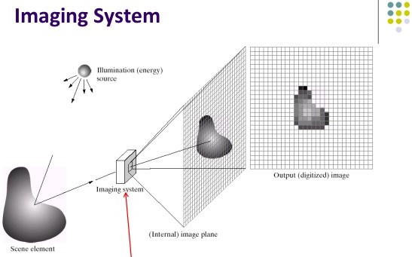

Slide 17

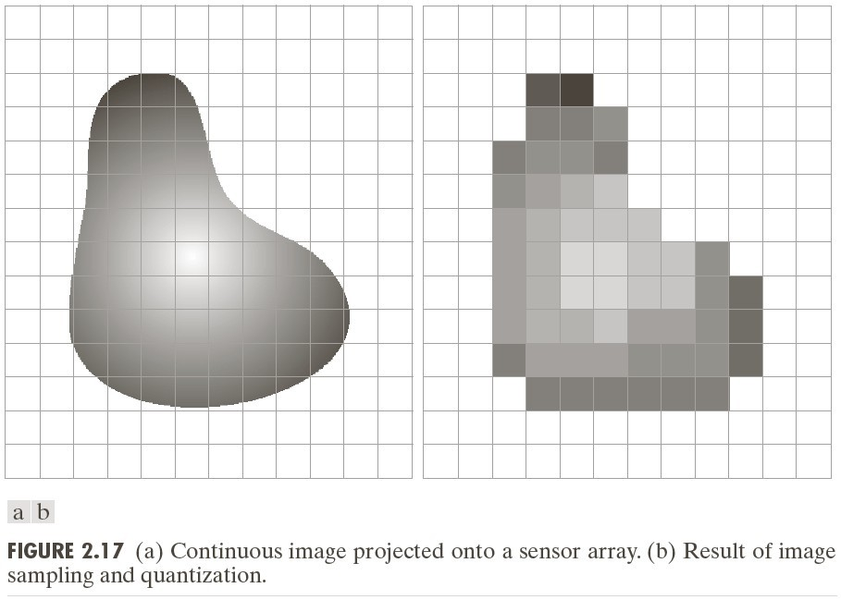
Image Sampling and Quantization
7

Slide 18
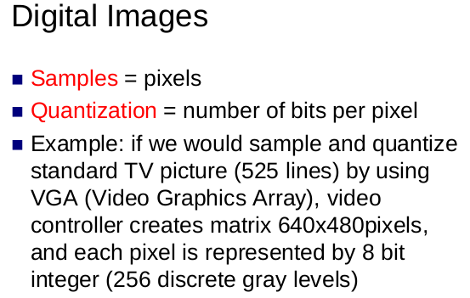
Wht is multimedia?

Slide 19
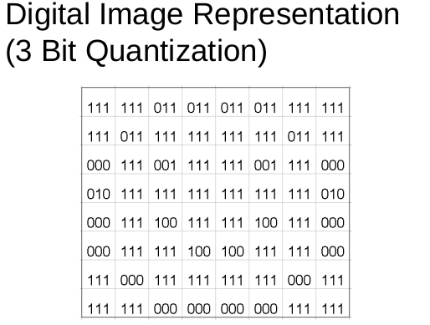
What is multimedia?

Slide 20
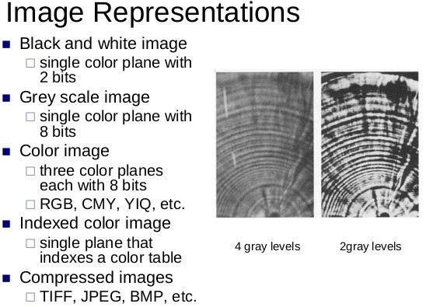
What is multimedia?

Slide 21
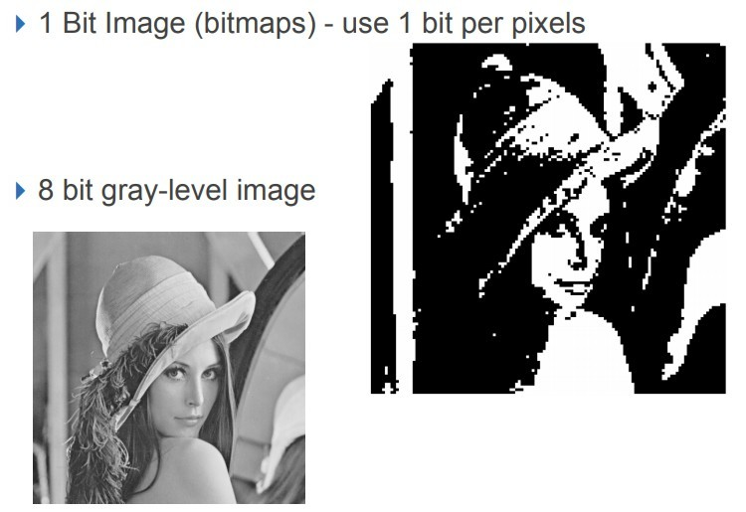
What is multimedia?

Slide 22
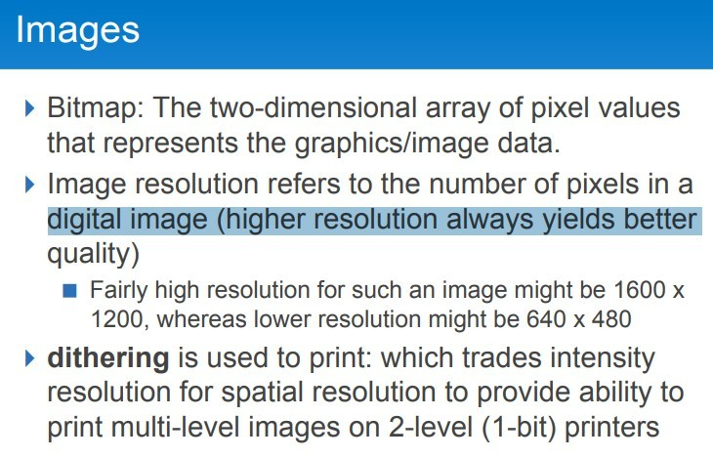
What is multimedia?

Slide 23
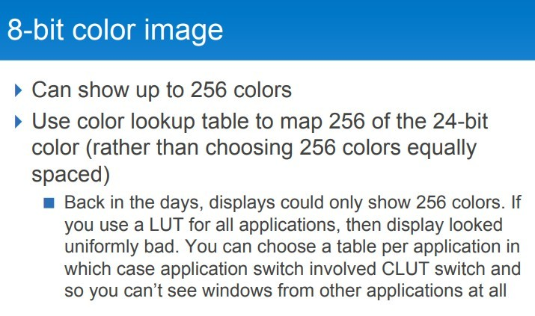
What is multimedia?

Slide 24
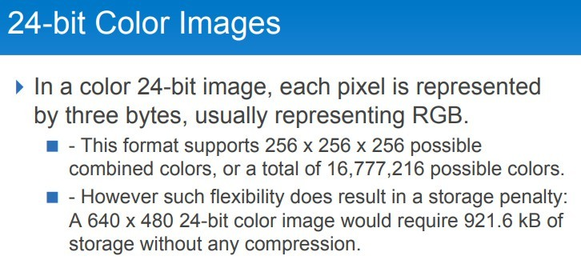
What is multimedia?

Slide 25
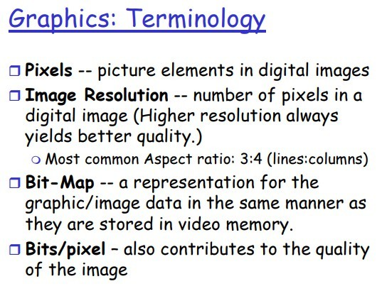
What is multimedia?

Slide 26
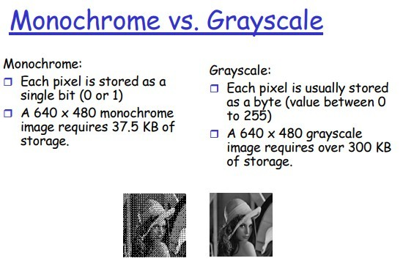
What is multimedia?

Slide 27
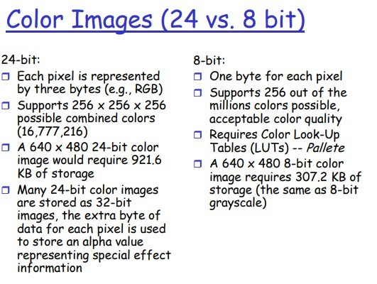
What is multimedia?

Slide 28
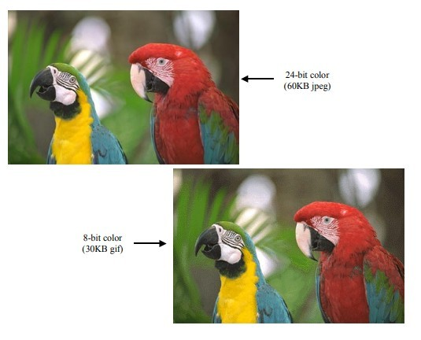
What is multimedia?

Slide 29
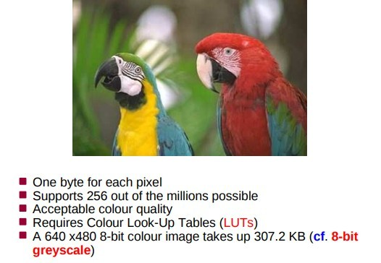
What is multimedia?

Slide 30
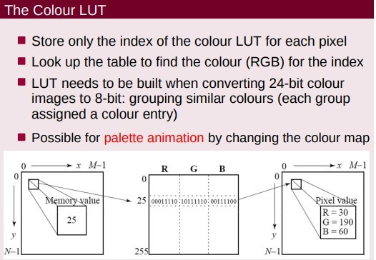
What is multimedia?

Slide 31
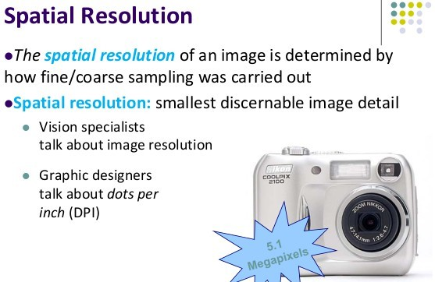
What is multimedia?

Slide 32
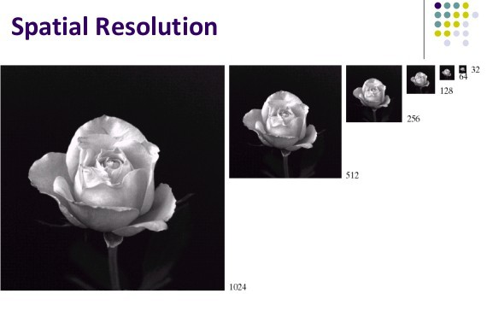
What is multimedia?

Slide 33
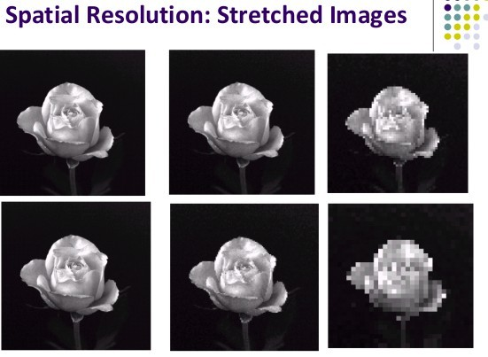
What is multimedia?

Slide 34
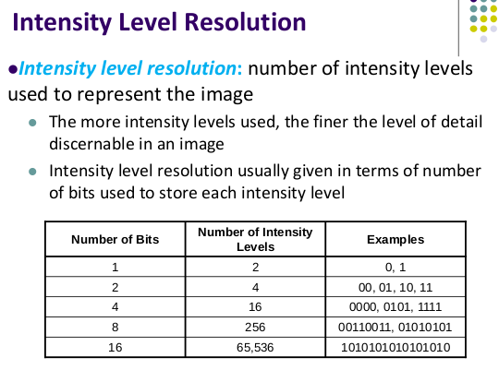
What is multimedia?

Slide 35
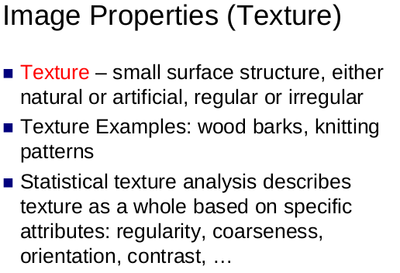
What is multimedia?

Slide 36
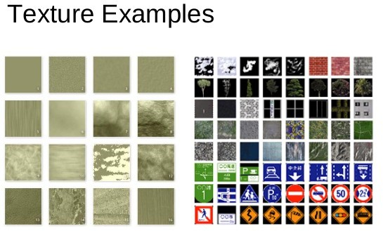

Slide 37
Digital Image Processing
Manipulation of Digital Images with different algorithms that takes digital image as the input and produces either new images, or features of images or interpretation of the images is called digital images processing.
Three types image processing: Low Level image processing: Middle Level Image processing: High level Image processing

Slide 38
General Image Processing Pipeline
Image Acquisition
↓
Image Preprocessing
↓
Image Enhancement
↓
Image Restoration
↓
Image Segmentation
↓
Feature Extraction
↓
Image Classification / Recognition
↓
Decision Making

Slide 39
Step 1: Image Acquisition
Definition
Image acquisition is the first step in image processing. It involves capturing an image using an imaging device and converting it into a digital format suitable for computer processing.
Step 2: Image Preprocessing
Image preprocessing improves the quality of the captured image before advanced analysis. The purpose is to remove unwanted distortions and prepare the image for further processing.
Step 3: Image Enhancement
Definition
Image enhancement improves the visual appearance of an image without changing its original content.
The objective is to make the image easier for humans or computers to interpret.
Step 4: Image Restoration
Definition
Image restoration reconstructs an image that has been degraded by blur, noise, or distortion using mathematical models.
Unlike enhancement, restoration attempts to recover the original image objectively.

Slide 40
Step 5: Image Segmentation
Definition
Image segmentation divides an image into meaningful regions or objects.
Each region represents an object or part of an object.
Step 6: Feature Extraction
Definition
Feature extraction identifies important characteristics of segmented objects.
Instead of processing every pixel, only relevant features are extracted.
Step 7: Image Classification and Recognition
Definition
Classification assigns an image or object to a predefined category, while recognition identifies the specific object.
Modern systems frequently use machine learning and deep learning techniques.
Step 8: Decision Making
Definition
The final stage uses the recognition results to perform an action or generate useful information.

Slide 41
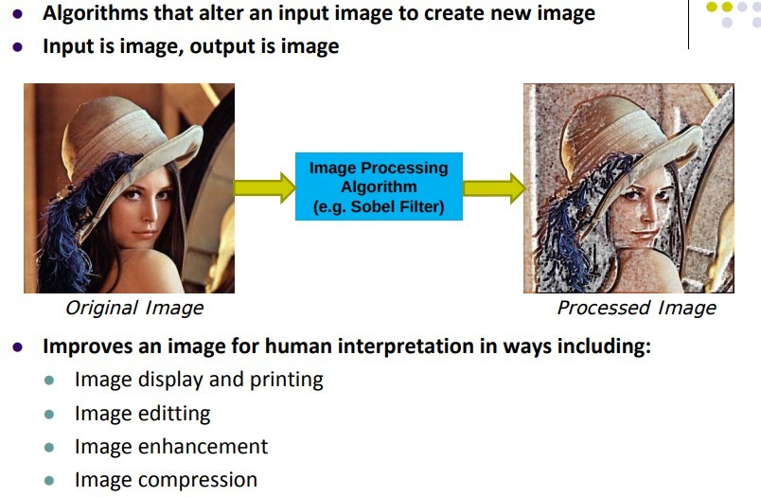
Digital Image Processing

Slide 42
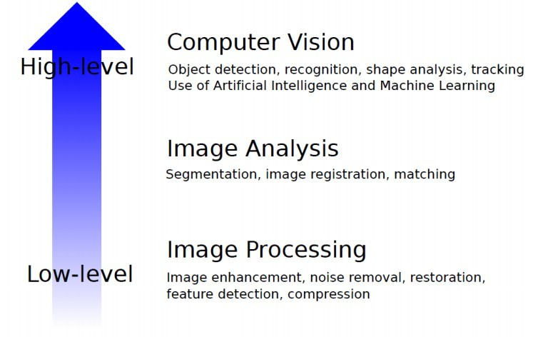
Digital Image Processing

Slide 43
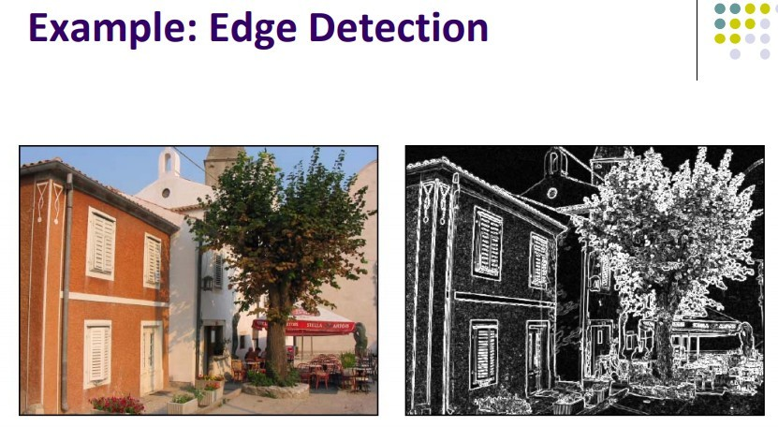
Low Level Image Processing

Slide 44
Low Level Image Processing
Primitive operations such as noise reduction, edge detection, contrast enhancement etc.
Input is image output is image

Slide 45
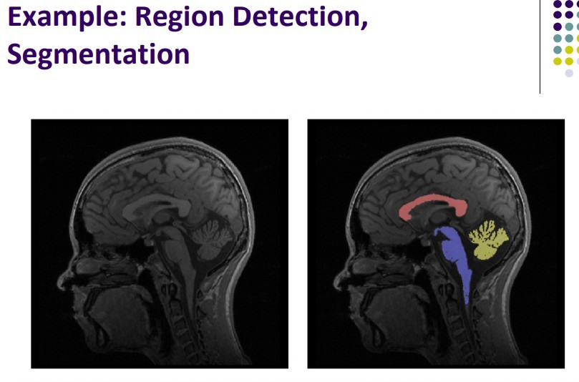
Mid-Level

Slide 46
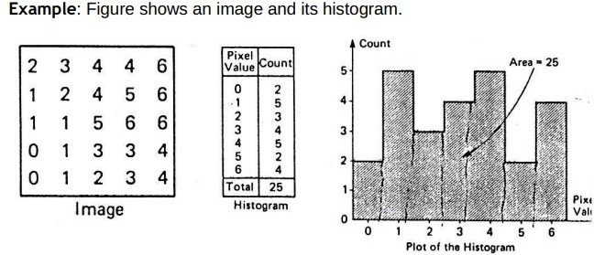
Mid-Level

Slide 47
Mid-Level
Generate the features or descriptors of the whole image or segmented image.
Input is image but output is features

Slide 48
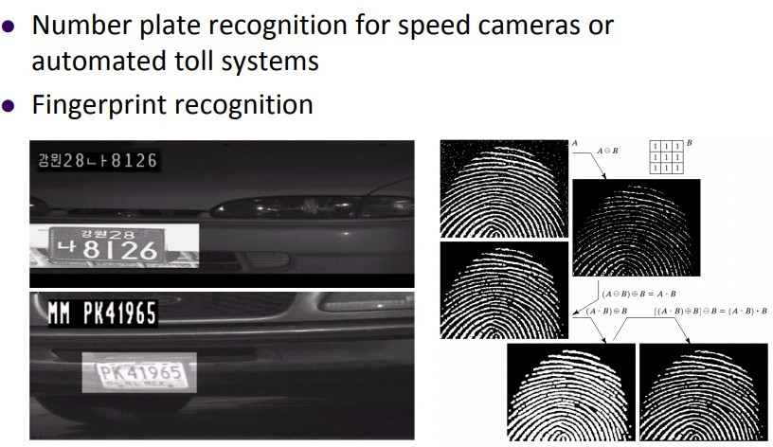
High Level

Slide 49
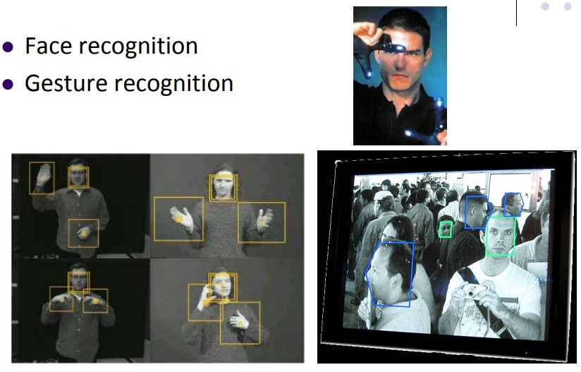
High Level

Slide 50
High Level
Generates the analysis or description of image such as what is in the image or what is image about.
For this low and middle processing is required.
Output is detection of object or description of the image.

Slide 51
Image Synthesis Process(stages)
Scene Description
│
▼
3D Object Modeling
│
▼
Lighting and Materials
│
▼
Camera/Viewpoint Setup
│
▼
Rendering
│
▼
Final Digital Image

Slide 52
Summary of the Image Synthesis Process
Step | Description | Example
1 | Scene Description | Define objects, environment, and camera
2 | Geometric Modeling | Build 2D/3D object shapes
3 | Material & Texture Assignment | Apply colors, textures, and surface properties
4 | Lighting Setup | Add ambient, point, directional, or spot lights
5 | Camera Configuration | Choose viewpoint and perspective
6 | Hidden Surface Removal | Remove invisible surfaces
7 | Rendering | Generate the final 2D image from the 3D scene

Slide 53
Image Transmission Process
Image Capture
│
▼
Compression
│
▼
Encoding
│
▼
Communication Channel
│
▼
Decoding
│
▼
Decompression
│
▼
Display

Slide 54
Summary of the Image Transmission Process
Step | Description
1 | Image Capture – Acquire the image using a camera or scanner
2 | Image Digitization – Convert the image into digital pixel values
3 | Image Compression – Reduce file size
4 | Image Encoding – Convert compressed data into a transmission-ready bit stream
5 | Transmission – Send the data through a wired or wireless channel
6 | Reception – Receive the transmitted data
7 | Decoding – Recover the encoded image data
8 | Decompression – Restore the image from its compressed form
9 | Reconstruction – Recreate the digital image
10 | Display – Present the image to the user

Slide 55
Image Recognition
It is also know as classification of image.
It classifies where image is about cat, dog,

Slide 56
Image Recognition Process
Image Acquisition
│
▼
Image Preprocessing
│
▼
Image Segmentation
│
▼
Feature Extraction
│
▼
Feature Selection
│
▼
Model Training (Machine Learning/Deep Learning)
│
▼
Image Classification
│
▼
Recognition & Decision

Slide 57
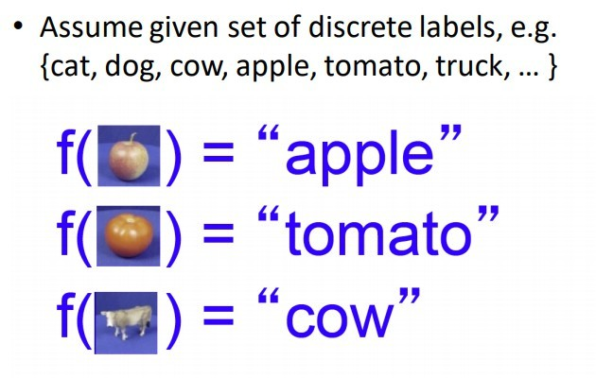
Image Recognition
It is also know as classification of image.
It classifies where image is about cat, dog,

Slide 58
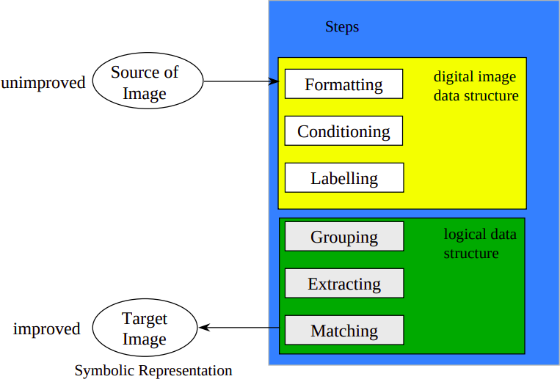
Image Recognition Steps

Slide 59
Image Recognition Steps
Formatting:
capturing of an image and transforming to a digital representation
Conditioning
image may contain uninteresting features due to noise or background.
Informative patterns may be modified by random variations
conditioning suppresses such features and highlight interesting parts of image.

Slide 60
Image Recognition Steps
Labeling:
  assumes informative pattern has structure
  analysis adjacent pixels, we can determine structure like edge
  edge detection identifies continuous adjacent pixels that differ greatly in intensity or color.
  corner detection is done in similar way
  edge and corner are labeled

Slide 61
Image Recognition Steps
Extraction:
-computes list of properties for each group of pixels
- for e.g. centroid, area, orientation, spatial moments

Slide 62
Image Recognition Steps
Matching:
  compares each object in the image with previously stored models
  determines best matching

Slide 63
File Formats:
Decided by compression techniques and number of colors

Slide 64
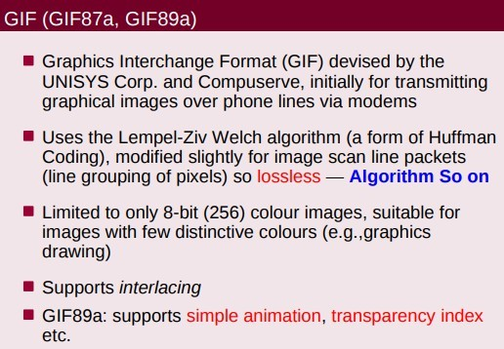
GIF

Slide 65
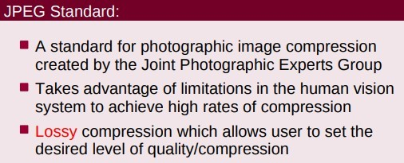
JPEG
Human eye can detect 900-1000 shades of color.

Slide 66
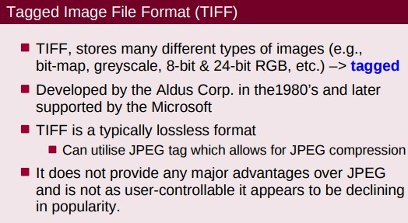
TIFF
More flexible as it can store compression, bit-level information, size of image

Slide 67
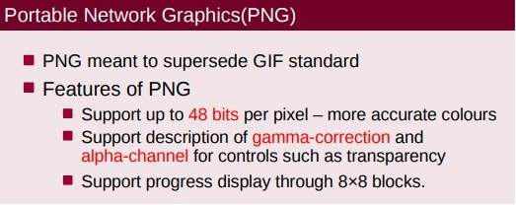
PNG
LWZ compression

Slide 68
PNG
Input intensity must be same to output intensity.
However, display system generate output similar to gamma function.
It means display system produces darker images.
So to display correct color, image is applied with inverse gamma function and then displayed.

Slide 69
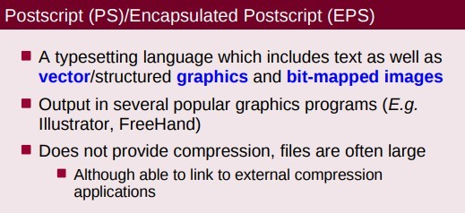
PS
PS has no compression stores in ASCII.

Slide 70
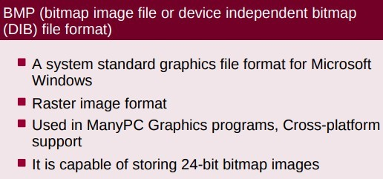
BMP
Used in paint

Slide 71
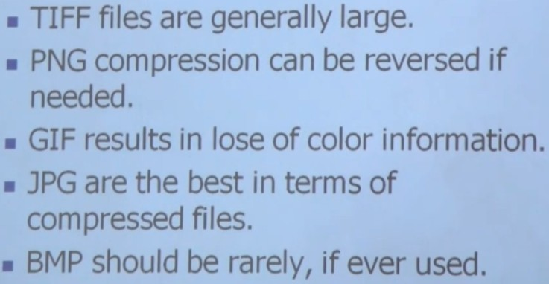
File Formats

Slide 72
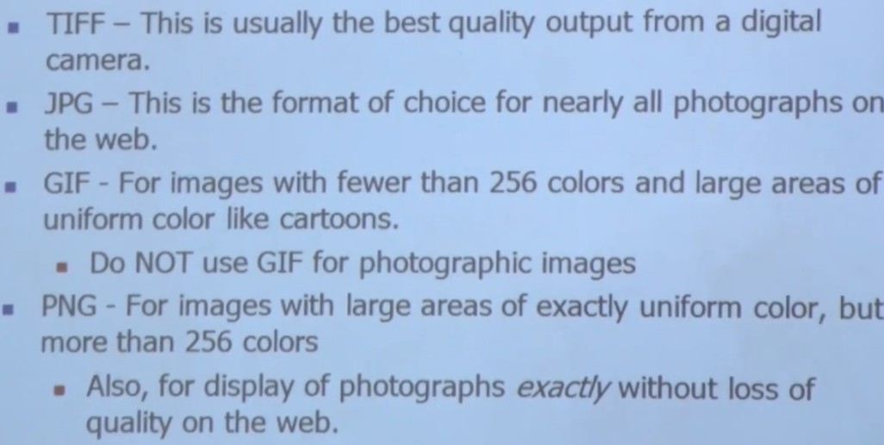
File Formats

Slide 73
Computer Graphics
Computer graphics is set of algorithms that generate or synthesize images and display them on the screen.
It is also known as computer graphics system.
Image consists of continuous geometric primitive such as line, and curves.
It means GC synthesizes images with these primitives.

Slide 74
Components of CG
Host Computer
Display Controller
Video Controller
Computer Host Interface

Slide 75
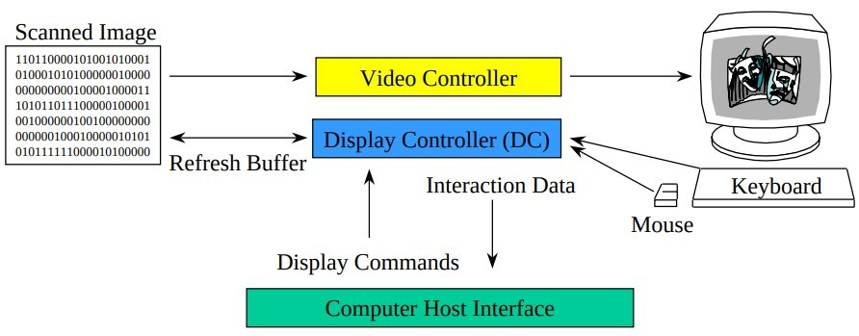
Components of CG
Host Computer
Display Controller
Video Controller
Computer Host Interface

Slide 76
Host Computer
All processing takes place
Generate display command to graphics processor

Slide 77
Display Controller
Also known as graphics processor or GPU.
Takes display command from host computer
Takes input from input devices
Output of display controller goes to video memory
Content of Video memory goes to Video Controller
Image generation is the multistage process requires multiple computations.

Slide 78
Display Controller
If image generation is done by CPU then, it will not have time for performing other actions.
Thus, rendering or displaying images is done by dedicated hardware called graphics card.
It will have its own processing unit.
Its generic name is display controller.
CPU assigns rendering task to display controller.

Slide 79
Display Controller
It performs multistage operations to generate or synthesize images.

Slide 80
Video Memory
It takes input, output from display controller
It stores image representation.
It stores images in digital format
It is also known as VRAM and is located in graphics card.

Slide 81
Video Controller
Converts stored digital image into analog voltage for display on CRT.
Which ultimately renders on the screen.
Screen contains grid of pixels.
Electricity excites the pixels and emits light of different intensities
This gives us sensation of color images.

Slide 82
Types of Graphics Devices
Vector Scan Devices
Raster Scan Devices

Slide 83
Vector Scan Devices
Excites only those pixels which are the part of image primitives.
It require complex hardware.
Expensive
Flickr may appear for complex scene as it excites random pixels.

Slide 84
Raster Scan Device
To render a raster image, all the pixels on the screen are considered.
Pixels are scanned sequentially top to bottom, left to right.
Video Controller start from top-left and checks if the pixel needs be excited.
It excites or leaves pixels unchanged based upon the image.
This continues upto bottom right pixel.

Slide 85
Raster Scan Device
The sequential consideration of pixels to excite is called scanning.
Each row of pixels is called scanning line.

Slide 86
Vector Image
Composed of mathematical formula which tells the path of image to be drawn and its color.
Can be scaled infinitely
Good for simple line art, logos.
Cannot comprise gradient of color, shadows and shading.
Extensions are SVG (Scalable Vector Graphics), EPS, PDF, AI
Can be crated using coraldraw, Illustrator

Slide 87
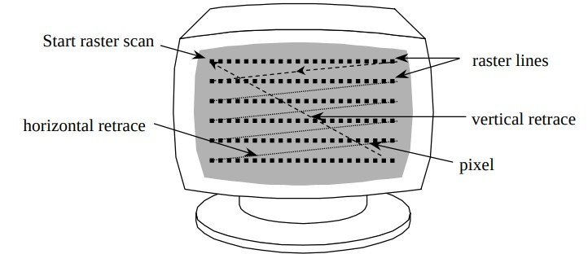
Raster Scan Device
Vector Scan Devices
Raster Scan Devices

Slide 88
Raster Scan Device
Video memory for raster scan is more commonly known as frame buffer.
Each contains one location for each pixel.
Thus size is equal to screen resolution.
Display controller works at the speed of CPU.
Video controller is much slower.

Slide 89
Raster Scan Device
For synchronization, frame buffer is used.
Two buffers used.
Video controller takes input from secondary buffer
While Display controller fills the primary buffer.

Slide 90
Screen Refreshing
Light from pixels after excitation starts decaying over time.
It might lead to fading of the screen.
Excitation of pixels does not occur simultaneously.
Thus fading does sync.
This leads to distortion of images

Slide 91
Screen Refreshing
To avoid this, we need to excite the pixels periodically.
This is called refreshing.
Refresh rate is the number of times a scene is refreshed per second.
Typically 60hz at least.

Slide 92
Pros and Cons of Raster Scan
Requires simpler hardware
Good for generating complex scene.
No flickr effect.
Cheaper and very popular.

Slide 93
Raster Image
Also known as bitmap image which is grid of pixels.
They can be compressed.
Created using photoshop or gimp
For e.g, GIF, JPG, PNG

